Slide 1
IELTS
GENERAL WRITING TASK 1

Slide 2
APOLOGY LETTER
1. What's it about?
You’ll need to give some background to the letter (these start with formal versions and then get less formal).
I am writing to apologize for my absence in the meeting on …. (formal). Please let me elaborate on my situation
I’m writing with regards to the …
I just received your email about the meeting…
Many thanks for your invitation to…
Just got your text about the party…
Sorry it’s taken me so long to write to you but at last I put pen to paper to explain why … (informal)

Slide 3
Introducing the apology
It’s probably best to get your apology in first before you give the explanation, and you might need to ‘soften the blow’.
Unfortunately I will be unable to attend…
I’m afraid I won’t be able to attend…
I’m really sorry but I have already made other arrangements…
What a pity! I can’t make it that day…
I am sincerely sorry for not being able to …. I am aware of the importance of the … but, unfortunately, my absence was unavoidable (formal)

Slide 4
How to say sorry
Dùng sau ‘What’s it about?’ (Dùng cuối đoạn đưa chi tiết vì sao xin lỗi)
Please accept my sincerest apologies for that issue (formal)
I’m (ever so) sorry I couldn’t make it to …. (informal)

Slide 5
Asking for forgiveness?
You don’t have to do this, but it depends on the question.
I sincerely hope that you are not too annoyed by (my actions, my mistake, this misunderstanding)
I hope you will forgive my absence/ mistake and be assured of my commitment to this company and its future. (formal)
I am so sorry for the delay in telling you. I hope that you can forgive me. (informal)
Taking responsibility
It might help to accept that you were to blame.
I take full responsibility for any inconvenience caused. Giải pháp
I realised that this is my fault. Giải pháp
I owe you an apology.
How careless/thoughtless/stupid of me!

Slide 6
Ending the letter
You might want to remind them about how sorry you are.
Once again, I sincerely regret missing the activities and hope you understand the unavoidable circumstances that led to my absence.
I hope that this will not cause too much inconvenience and would be very grateful if you could keep me up to speed with any developments. 1
I hope the meeting goes well and look forward to hearing about the plans as soon as possible.
I really hope you will accept my profound apologies. 2
Please let me know if you have any further issues
Hope you have a great time at your party!

Slide 7
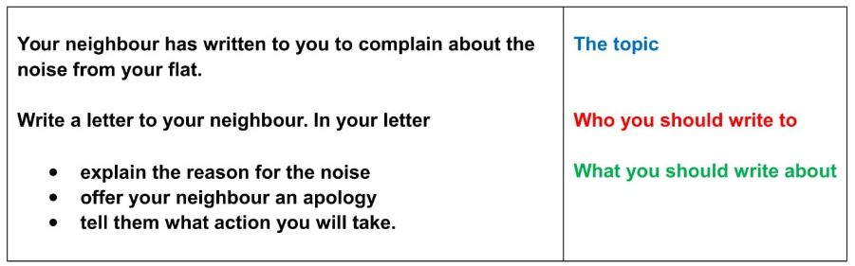
Dear Mr. Hoàng,
I am writing to apologize for the noise from my flat. Please let me elaborate on my situation.
To explain in little more detail, (giải thích)
I sincerely hope that you are not too annoyed by the noise. I will do everything possible to avoid this happening again.
(Đưa ra hành động cải thiện)
I hope that this will not cause too much inconvenience and would be very grateful if you could keep me up to speed with any developments.
Please let me know if you have any further issues
Yours sincerely,
Nhan

Slide 8
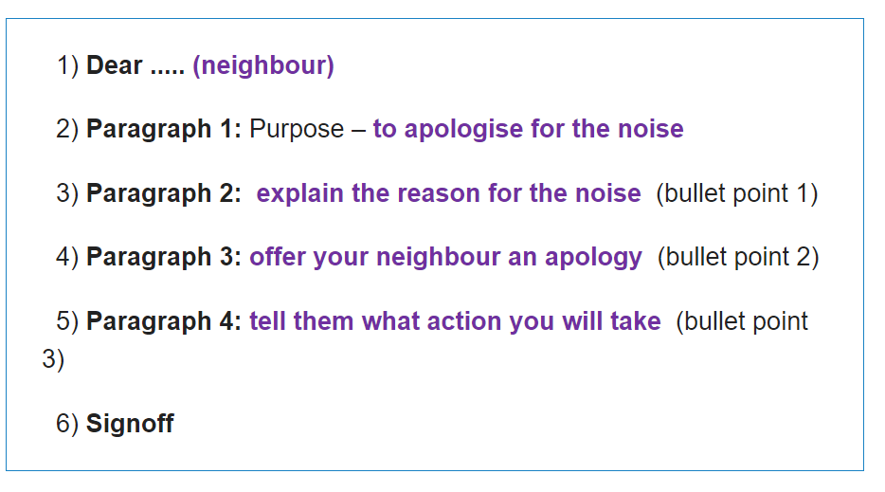

Slide 9
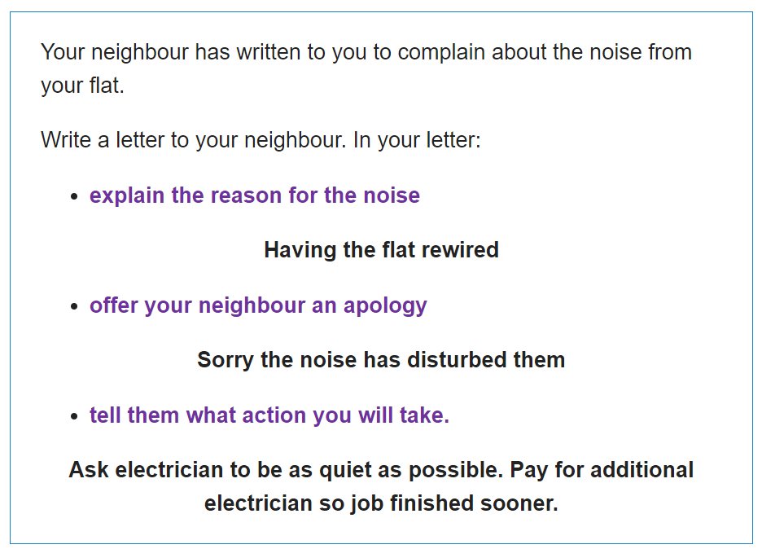

Slide 10
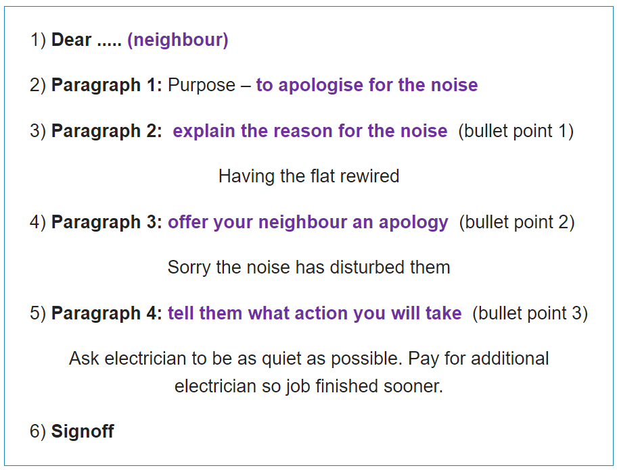

Slide 11
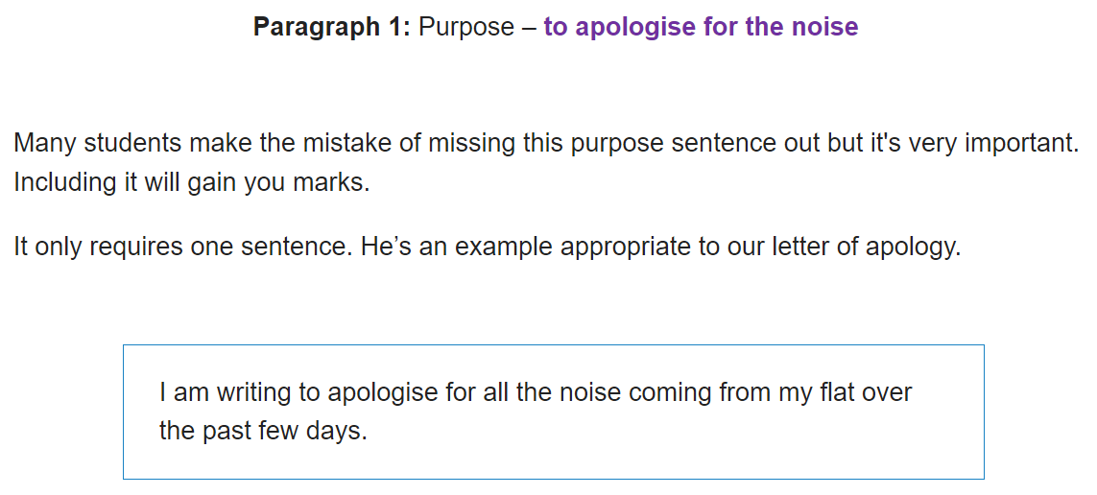

Slide 12
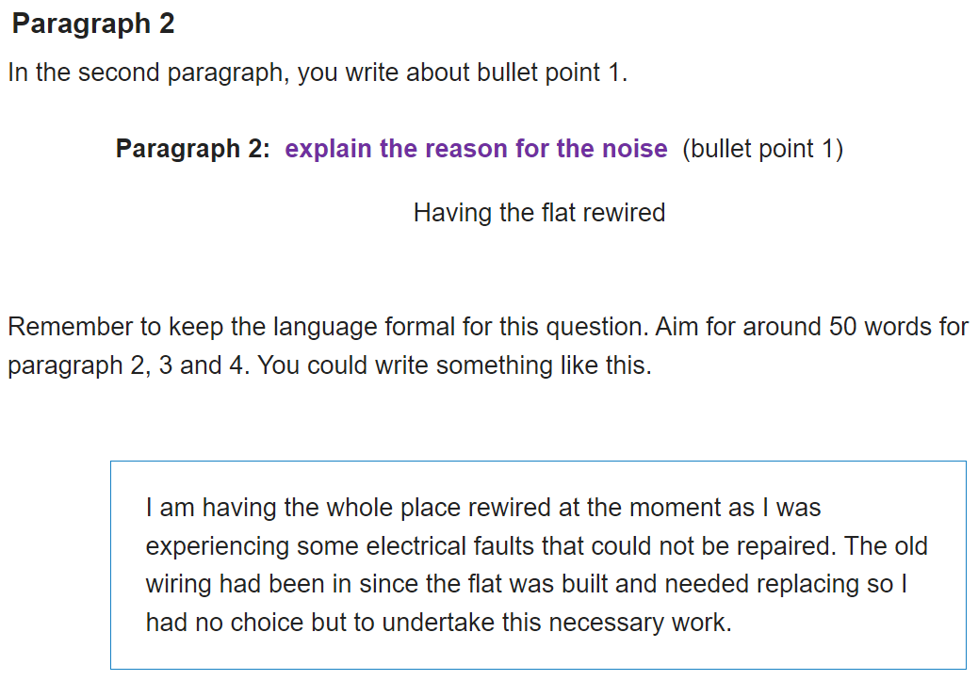

Slide 13
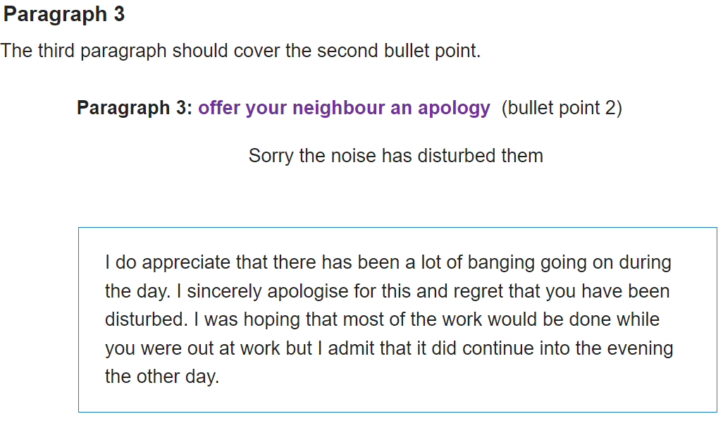

Slide 14
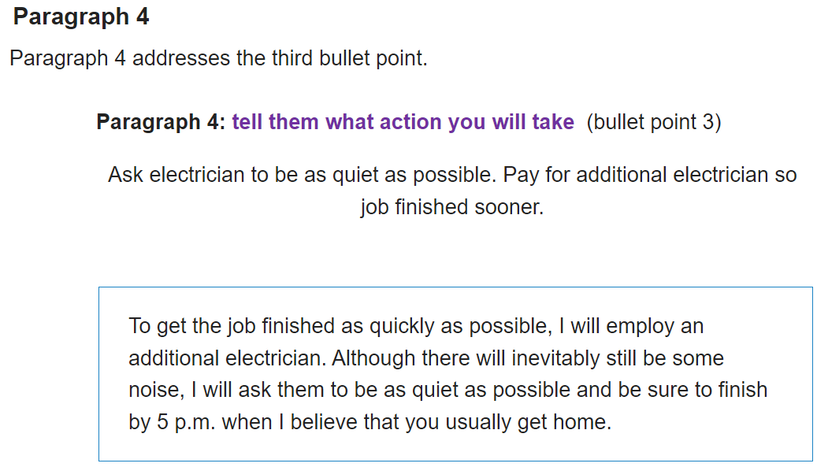

Slide 15
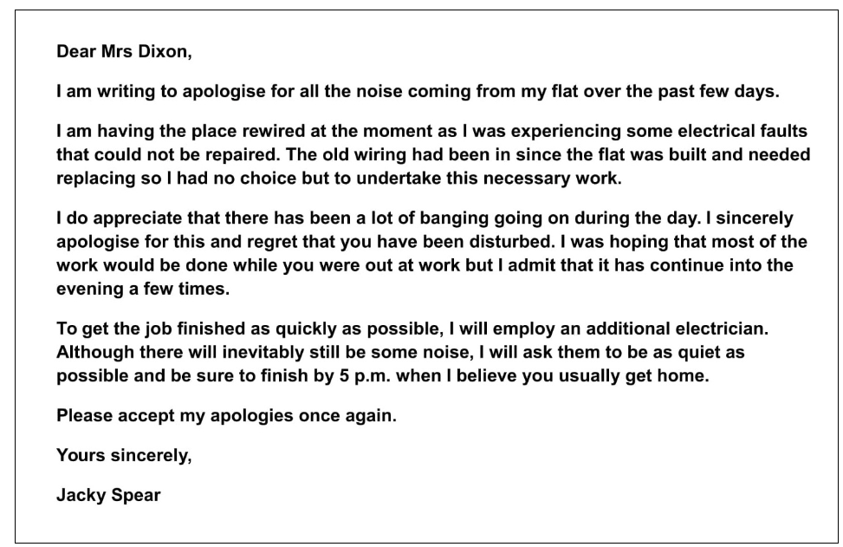

Slide 16
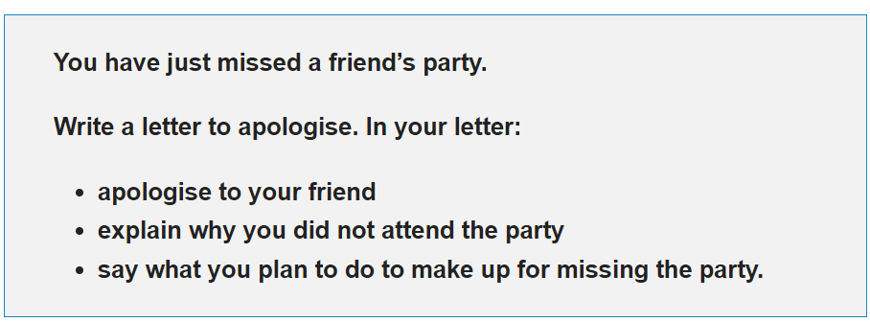

Slide 17
